Slide 1
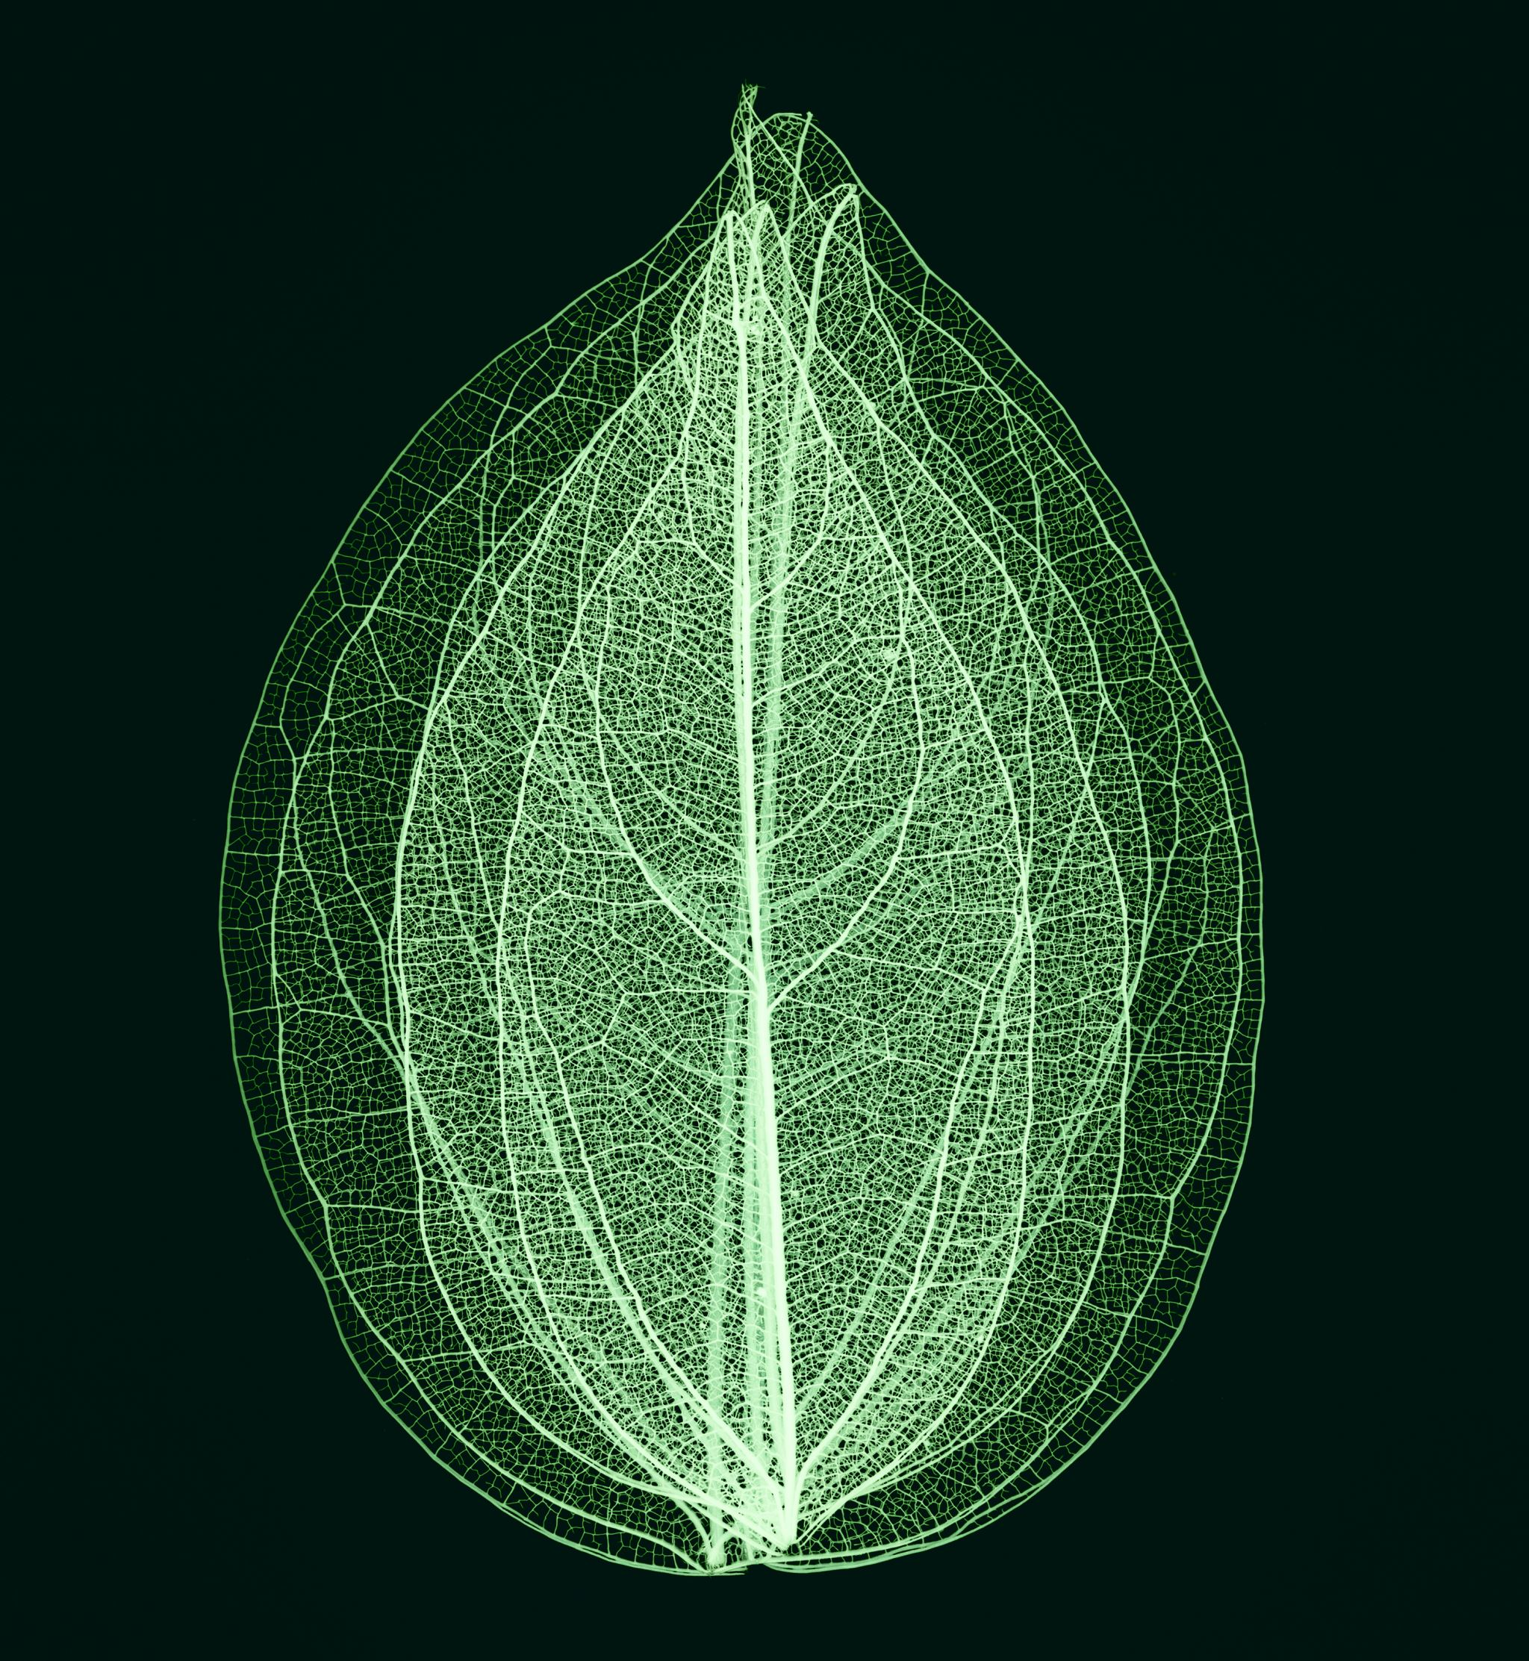
Recognition of crop disease with deep learning based on leaf images

Slide 2

Group Members Information
MANSUR SHAIK - 700752385
NAVASAI GANGIREDDY - 700754033
SAI RAM UPPALAPATI - 700740307
YAMINI SARASWATHI BORRA - 700748022

Slide 3
Roles/Responsibilities and Contribution
1. MANSUR SHAIK
Worked on dataset, algorithm
2. YAMINI SARASWATHI BORRA
Worked on dataset, algorithm
3. NAVASAI GANGIREDDY
Worked on algorithm and Report
4. SAI RAM UPPALAPATI
Worked on algorithm and Report

Slide 4
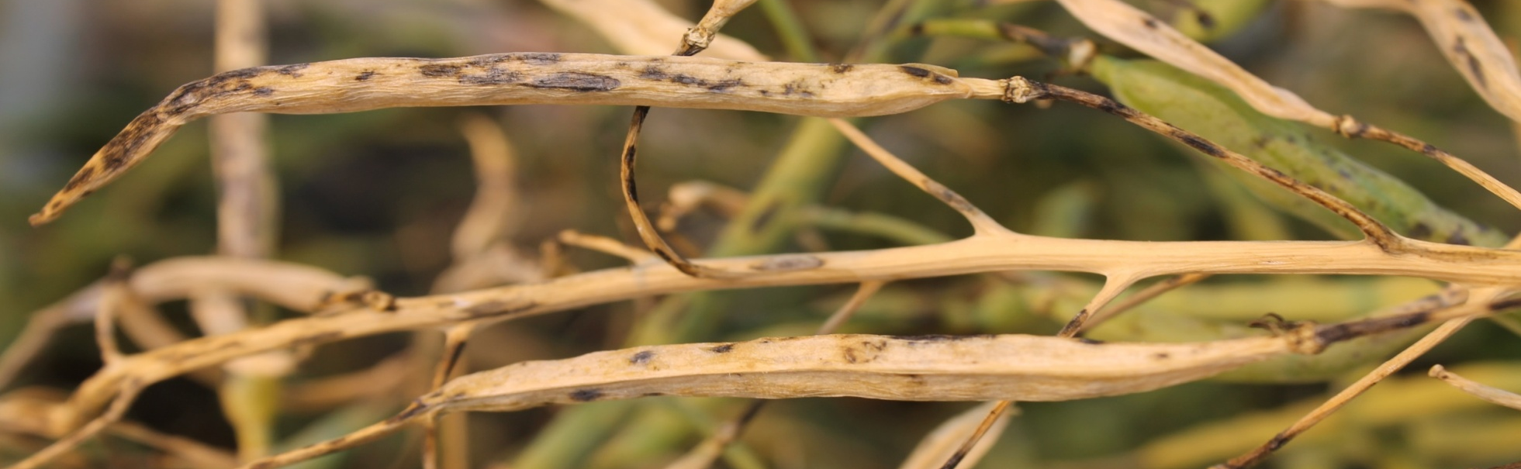
Motivation
Agriculture faces challenges from unpredictable weather patterns and the increasing prevalence of crop diseases and pests, necessitating advanced technological solutions.
Motivation for Change: The need for more accurate, efficient, and proactive systems drives the exploration of advanced technologies in this research.

Slide 5
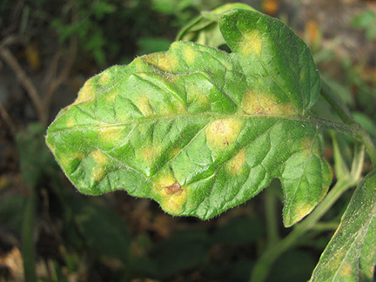
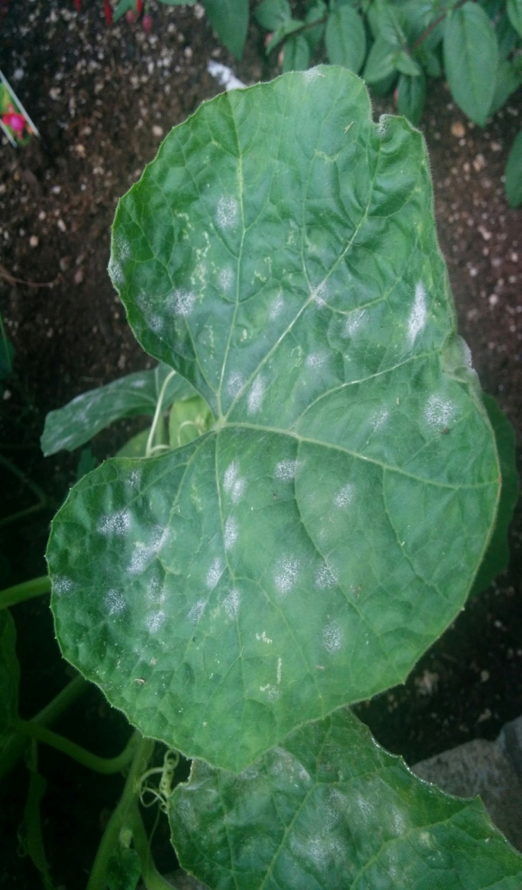
Objective
Objective
Develop and deploy a deep learning framework to revolutionize crop management, focusing on accurate identification of diseases and pests in harsh environments, with the aim of enhancing agricultural resilience and sustainability

Slide 6
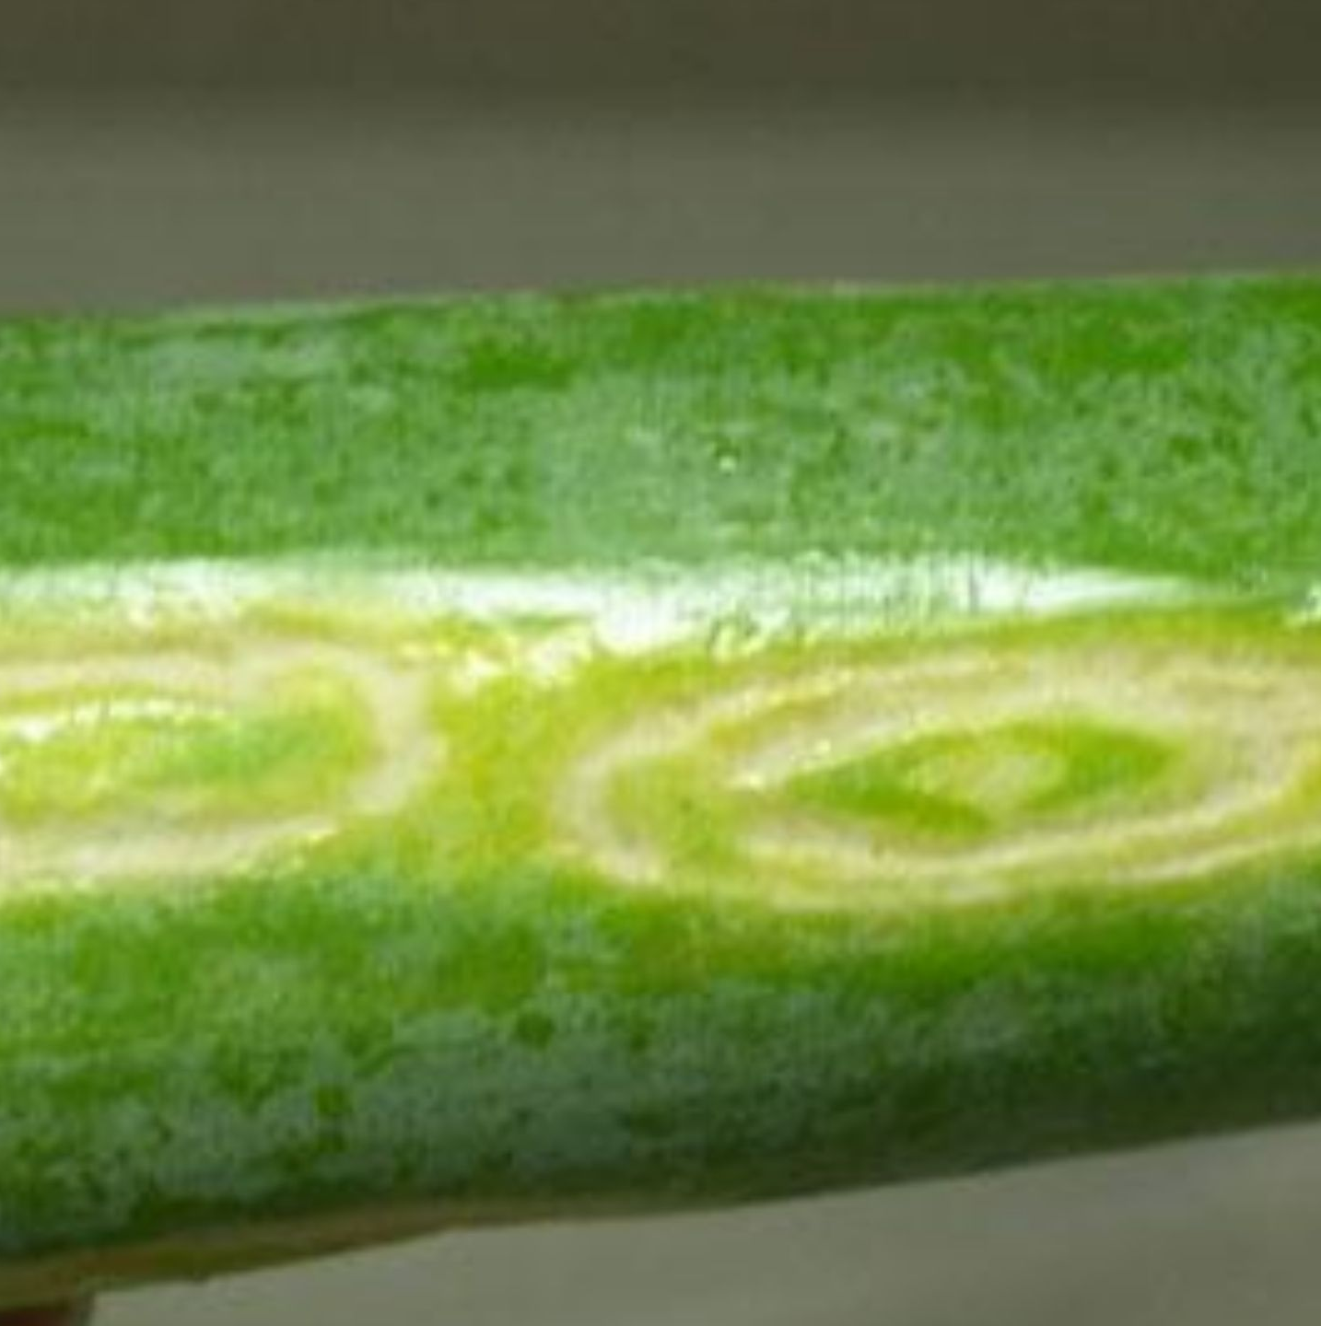
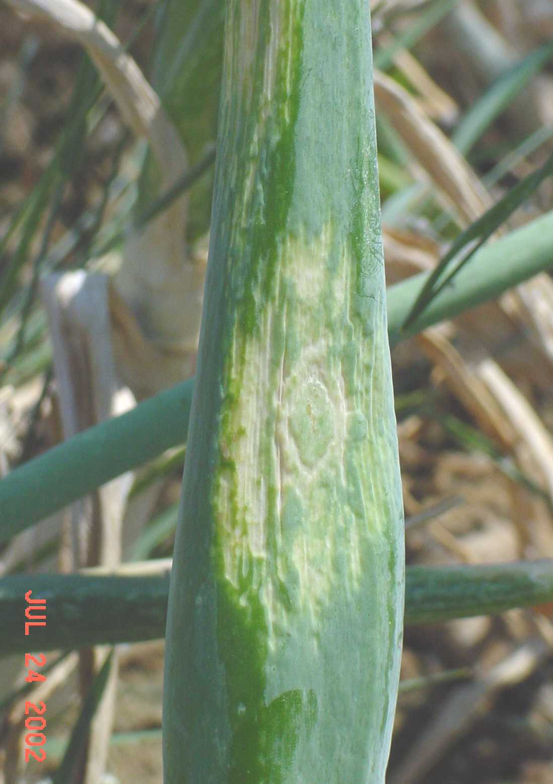
Related Work
Current agricultural research employs sensor networks and automated systems for crop disease identification, including real-time weather-based detection and wireless image sensors for pest traps.
Machine learning, specifically neural networks, proves effective in diagnosing plant diseases by analyzing color, shape, and texture features.
Image processing methods enhance disease detection, demonstrated in successful applications like identifying scab disease in potatoes.

Slide 7
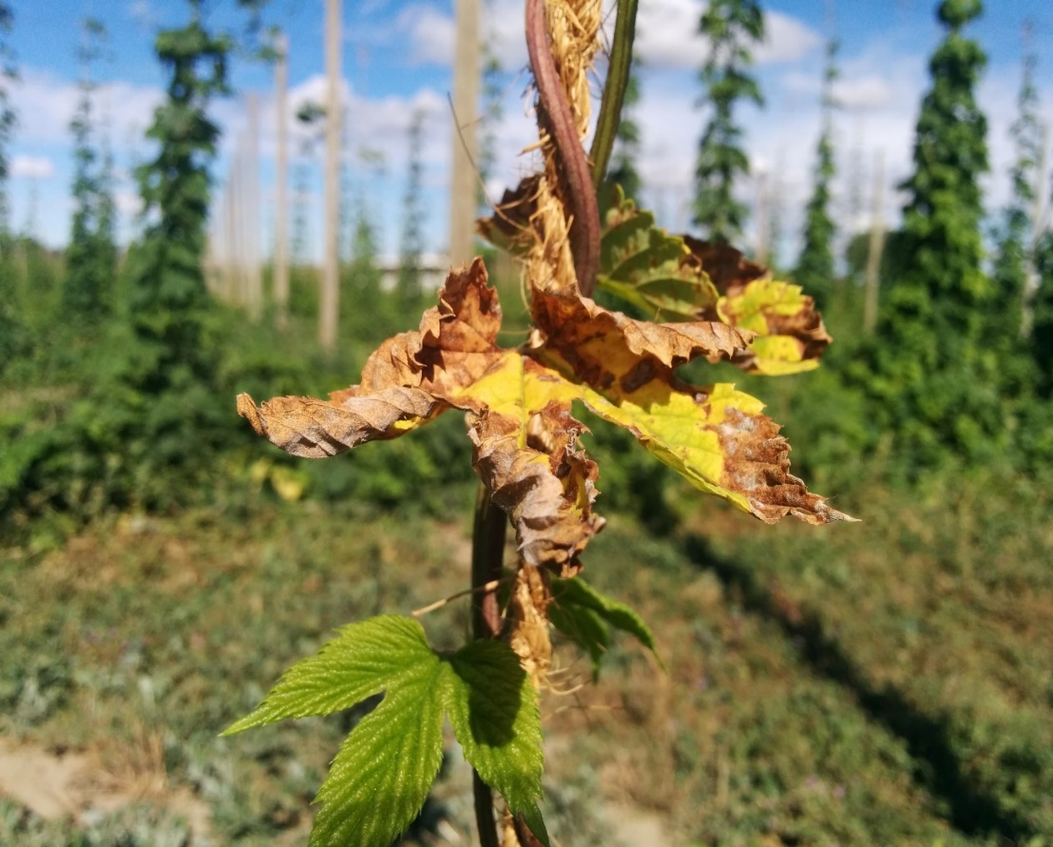
Problem Statement
The current methods for crop disease and pest detection suffer from inefficiency, error proneness, and inadequate early detection capabilities, resulting in potential agricultural losses.
Additionally, challenges such as extreme weather conditions, limited data availability, soil variations, and a technology gap further hinder effective detection.
The reliance on time-consuming manual methods introduces human error and may not offer timely identification, exacerbating the agricultural risks.

Slide 8
Convolution Neural Network
Input Layer: Receives raw data, often images.
Convolutional Operation: Applies filters to capture local patterns.
Activation Function (ReLU): Introduces non-linearity to enhance learning.
Pooling: Reduces dimensionality through down-sampling.
Flattening: Converts processed data into a one-dimensional vector.
Fully Connected Layers: Integrates information for global predictions.
Output Layer: Produces final network predictions.
Loss Function: Measures the difference between predictions and labels.
Back propagation: Updates weights based on calculated gradients.
Training and Iteration: Repeats forward and backward passes iteratively for learning hierarchical representations.

Slide 9
Proposed Solution
Model: Inception-ResNet-v2 network with added residual units for crop disease recognition. Cross-layer direct edges and multi-way convolution layers enhance accuracy and solve gradient issues.
Data Set: Crop Disease Recognition Competition dataset from the 2018 AI Challenger Competition. It includes 47,363 images of 27 diseases across 10 crops, divided into training (70%), validation (10%), and test sets (20%).
Image Pre-processing: Applies light transformation and random clipping to enhance feature information and address data set distribution issues.

Slide 10
This preprocessing method includes geometric space transformations and pixel color transformations
Training Strategy: Adopts the Inception-ResNet-v2 model for transfer learning, loading pre-trained parameters, modifying the model for the target task, and fine-tuning. Parameters, learning rate, batch size, dropout, loss function, and optimizer are set for efficient training.
Achieves a final accuracy of 86.1%, outperforming other common deep learning models. The system effectively identifies crop diseases and pests, providing valuable information and guidance for farmers.

Slide 11
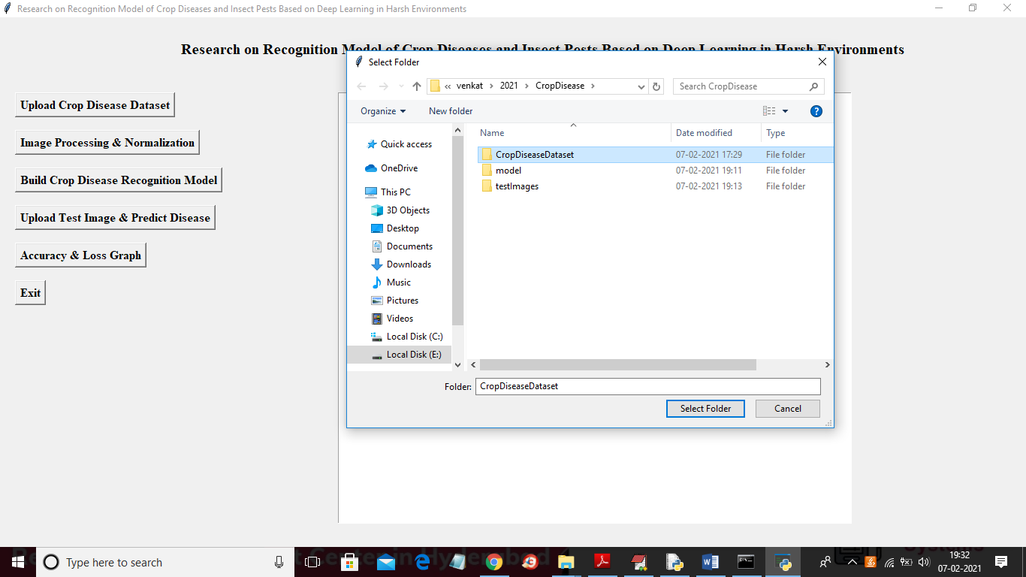
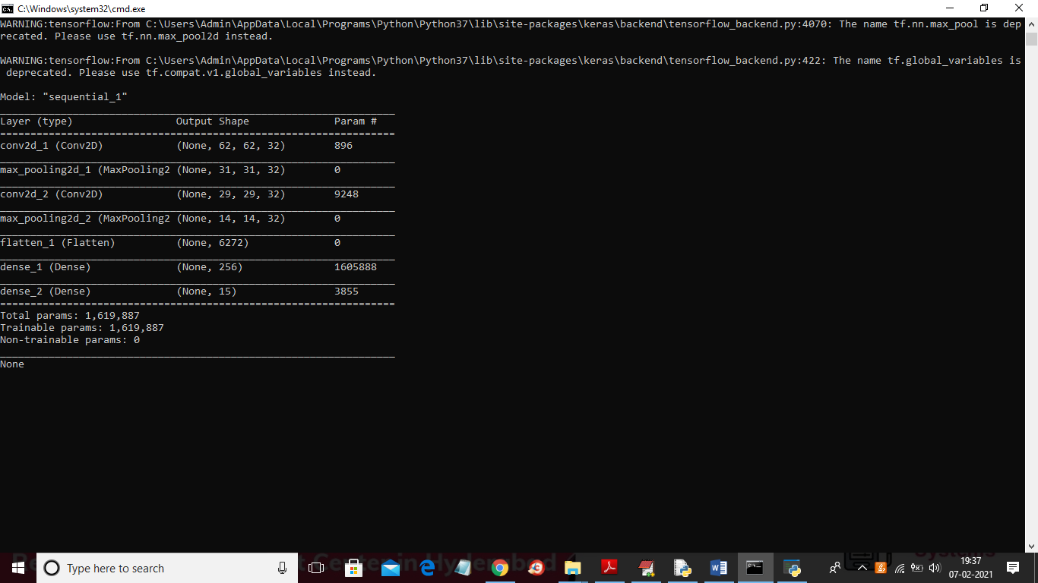
Result

Slide 12
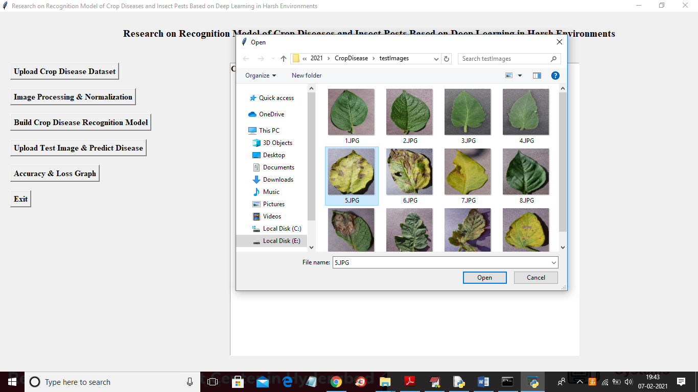
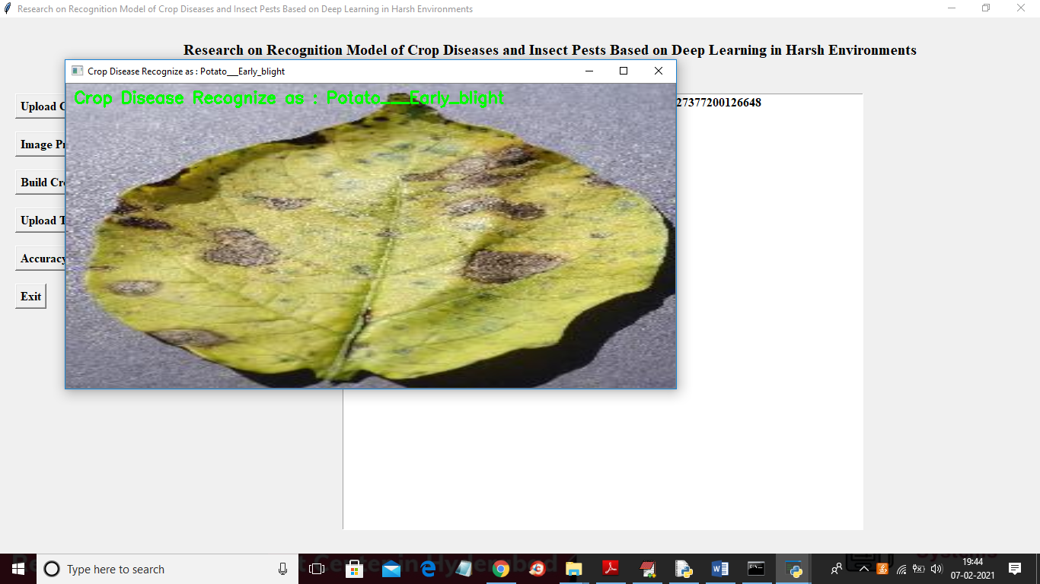
Result

Slide 13
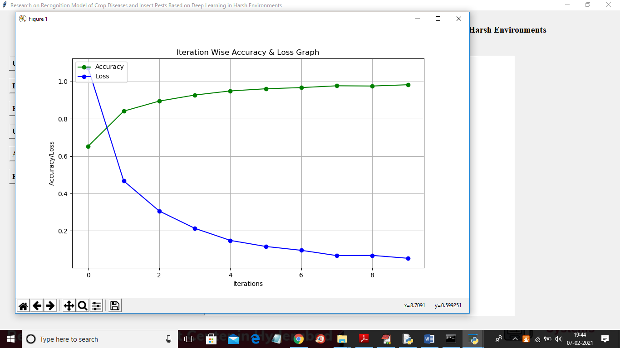
Accuracy and loss Graph

Slide 14
Reference
[1] J. Schmidhuber, ‘‘Deep learning in neural networks: An overview,’’ Neural Netw., vol. 61, pp. 85–117, Jan. 2015.
[2] A.-R. Mohamed, G. E. Dahl, and G. Hinton, ‘‘Acoustic modeling using deep belief networks,’’ IEEE Trans. Audio, Speech, Lang. Process., vol. 20, no. 1, pp. 14–22, Jan. 2012.
[3] Y. Bengio and O. Delalleau, ‘‘On the expressive power of deep
[4]architectures,’’ in Proc. 14th Int. Conf. Discovery Sci. Berlin, Germany, 2011, no. 1, pp. 18–36.

